Slide 1
Systems Administration
DNS Domain Name Server

Slide 2
Network management
Keep the network healthy
Fault detection for networks, gateways, and critical servers
Schemes for notifying an administrator of problems
General network monitoring
Documentation and visualisation of the network
Administration of network devices from a central site

Slide 3
FCAPS
Fault Management
Configuration Management
Accounting Management
Performance Management
Security Management

Slide 4
Some principles first
Make one change at a time.
Document the situation as it was before you got involved, and document every change you make
Start at one end of a network and work through the system’s critical component
Communicate regularly
Work as a team
Use the layers of the network to negotiate the problem. Start at the “top” or “bottom”.

Slide 5
Network trouble shooting
Do you have physical connectivity?
Is your interface configured properly?
Do your ARP tables show other hosts?
Is there a firewall on your local machine?
Is there a firewall anywhere between you and your destination?
Is firewalls are involved, do they pass ping packets?
Can you ping the localhost?
Can you ping other local hosts by IP address?
Is DNS working properly?
Can you ping other local hosts by hostname?
Can you ping hosts on another network?
Do high level services work?

Slide 6
ping
The ping command send an ICMP ECHO_REQUEST packet to a target host and waits to see if the host answers back.
Routing tables, physical networks, and gateways are all involved.
The output for ping shows the host’s IP address, the ICMP sequence number of each response packet, and the round trip travel time.
Use –n option if you suspect that DNS is not working

Slide 7
What information can you get from ping
ICMP sequence number tells you if packets have been dropped. If packets have been dropped, then
run traceroute to discover the route to the target host
ping the intermediate gateways in sequence
The round trip time gives you insights into the overall performance of a path through a network.

Slide 8
traceroute
The traceroute command uncovers the sequence of gateways through which an IP packet travels to reach its destination.
traceroute works by setting the time-to-live field (TTL) of an outbound packet to an artificially low number.
There are traceroute-like utilities, try mtr
Inverse traceroute, see http://traceroute.org

Slide 9
netstat
netstat collects a wealth of information about the state of your computer’s networking software
Interface statistics
Routing information
Connection tables
netstat can be used to
Inspect interface configuration information
Monitor the status of network connections
Identify listening network services
Examine the routing table
View the operational statistics for various network protocols

Slide 10
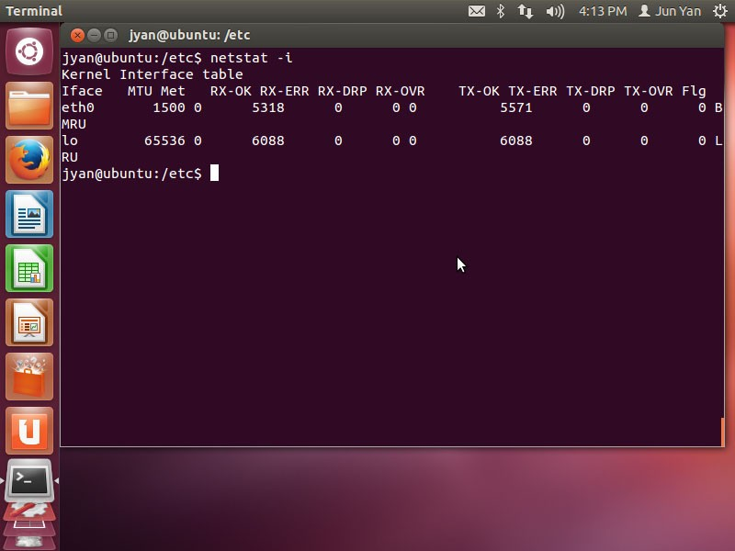
Inspecting interface configuration

Slide 11
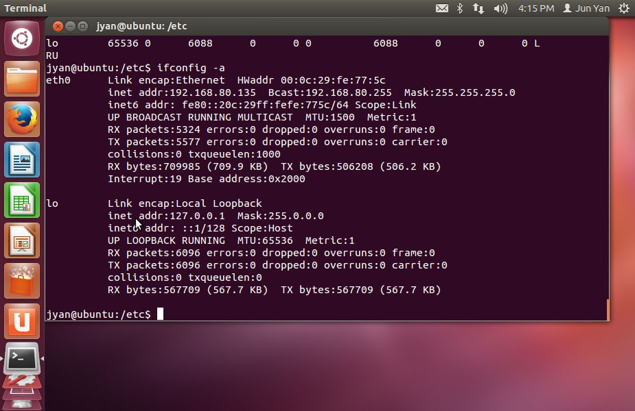

Slide 12
Errors can show up. A large number of errors on a single machine suggests a problem
What are the error rates of the neighbouring machines?
Is there a problem with that machine’s interface or connection?
Or is there a media or network problem?
You should not see collisions even when the network is under heavy load
Is the flow control enabled on your switches and routers?

Slide 13
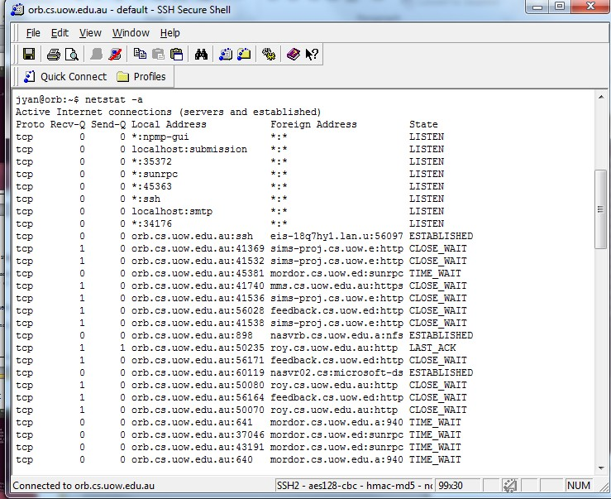
Monitoring the status of network
Document title

Slide 14
Send-Q and Recv-Q show the sizes of the local host’s send and receive queues for the connection
These numbers should tend toward 0
State has meaning for TCP only
LISTEN
ESTABLISHED
TIME_WAIT
netstat –a is primarily useful for debugging higher-level problems once you have determined that basic networking facilities are working correctly
E.g., the state SYN_SENT identifies a process that is trying to contact a non-existent network server
What about SYN_WAIT?

Slide 15
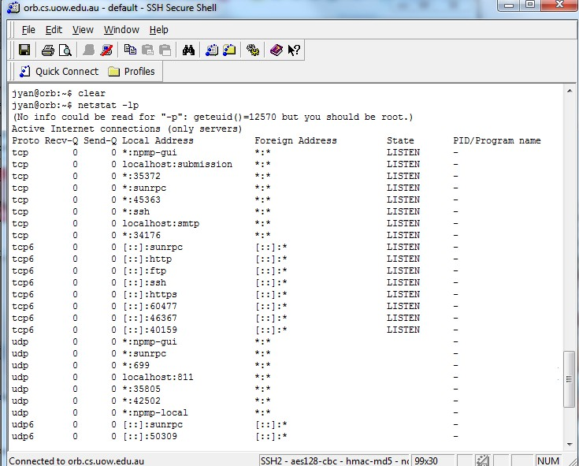
Identifying listening network services

Slide 16
What processes on this machine are listening on the network for incoming connections?
It’s also helpful to look at machines from an outsider’s perspective by running a port scanner such as nmap.

Slide 17
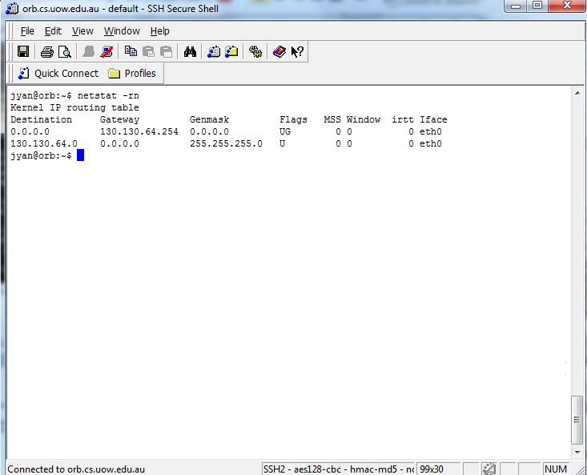
Examining the routing table

Slide 18
Flags characterise the route
U means up
G is a gateway
H is a host route
D indicates a route resulting from an ICMP redirect

Slide 19
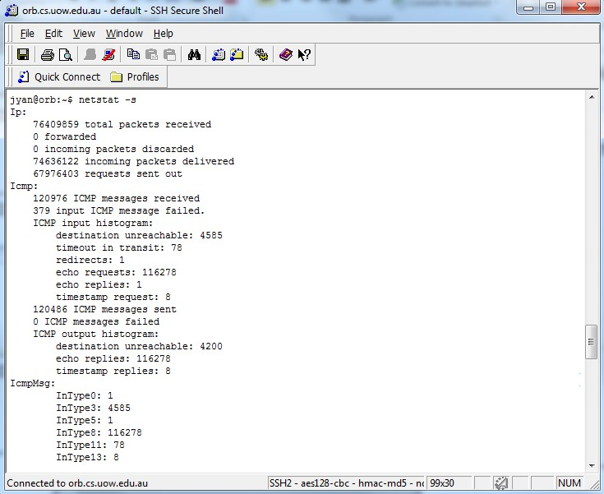
Viewing operational statistics
Document title

Slide 20
netstat –s dumps the contents of counters that are scattered throughout the network code.
The output has separate sections for IP, ICMP, TCP, and UDP
Pay attention to number of packets that are dropped or discarded
It’s a good idea to develop a feel for the normal ranges of these statistics so that you can recognise pathological states.

Slide 21
Inspection of live interface activity
One good way to identify network problems is to look at what’s happening right now
Linux uses a too called sar
sar –n DEV 2 30 shows
Number of packets
Bandwidth in use
Number of compressed packets
Number of multicast packets Evert 2 seconds for 1 minute

Slide 22
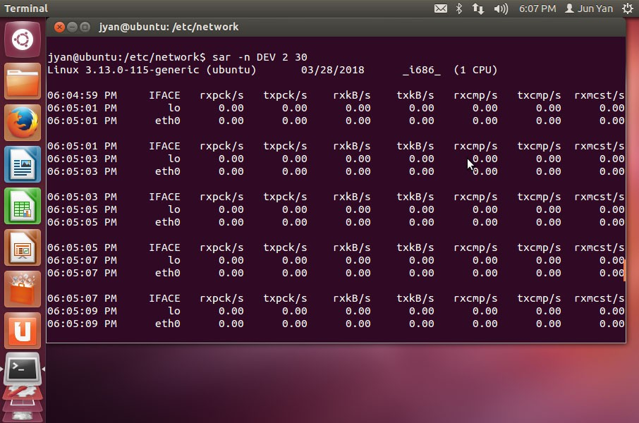

Slide 23
tcpdump
tcpdump is a packet sniffer that listens to network traffic and record packets that meet criteria of your choice, for example
Inspect all packets send to or from a particular host
TCP packets related to one particular network connection
Do not invade the privacy of your users.
Sniffers must run as root.
Packet sniffers can produce an overwhelming amount of information.
You might want to try another tool called Wireshark

Slide 24
Common options
-i: force an interface
-n: stop name lookups
-v: increase the information you see about packets
-vv: even more data
-w: store packets to a file (only header)
-r: read packets from a file

Slide 25
Some examples
$ sudo tcpdump host bull
$ sudo tcpdump src net 192.168.1.0/24 and dst port 80

Slide 26
SNMP
Simple Network Management Protocol
Is governed by IETF (RFC 1157)
Is designed to be simple
Only five commands in version 1
Is concerned with network management
Manage network performance
Identify and diagnose issues
Baseline/plan for network growth
Key elements
Management Station/Manager
Agent
Management Information Base
Network Management Protocol

Slide 27
SNMP
Uses an agent/station model
An SNMP agent is software capable of answering valid queries from an SNMP station
An SNMP station, such as a network management system, is software capable of forming queries based on information defined in the MIB

Slide 28
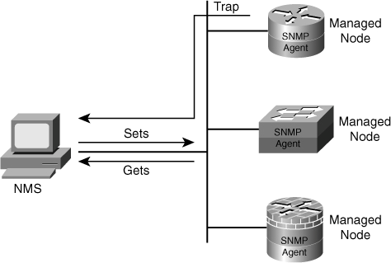
SNMP
A client/server architecture

Slide 29
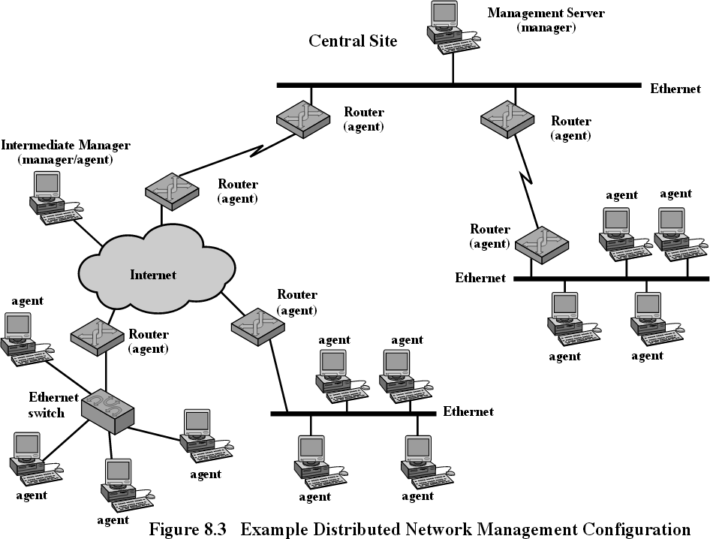

Slide 30
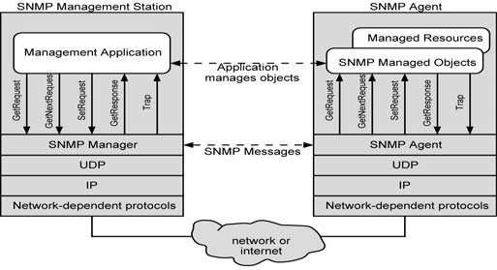
SNMP
SNMP configuration

Slide 31
SNMP
Three basic ideas
A manager checks an agent by requesting information that reflects the behaviour of the agent
A manager forces an agent to perform a task by resetting values in the agent database
An agent contributes to the management process by warning the manager of an unusual situation

Slide 32
SNMP V1
Get-Request
Polls agents for information
Get-Next-Request
Requests the next item in a dataset
Set
Requests a change to a value
Get-Response
Sends a response to a Manager request
Trap
Informs a Manager of an event

Slide 33
SNMP traps
Seven types of SNMP traps are defined
Coldstart of a system
Warmstart of a system
Link Down
Link Up
Failure of authentication
Exterior Gateway Protocol (EGP) neighbour loss
Enterprise specific

Slide 34
SNMP
Structure of Management Information (SMI)
Data definition language for objects
Management Information Base
Distributed network management data

Slide 35
What Is an SNMP-Compliant MIB?
Each management station or agent in an SNMP- managed network maintains a local database of information relevant to network management, known as the management information base (MIB).
An MIB contains definitions and information about the properties of managed resources and the services that the agents support. The manageable features of resources, as defined in an SNMP-compliant MIB, are called managed objects or management variables (or just objects or variables).

Slide 36
What Is an SNMP-Compliant MIB?
Each management station or agent in an SNMP- managed network maintains a local store of information relevant to network management, known as the management information base (MIB).
An MIB contains definitions and information about the properties of managed resources and the services that the agents support. The manageable features of resources, as defined in an SNMP-compliant MIB, are called managed objects or management variables (or just objects or variables).

Slide 37
Categories of management information
State information –
this is information about the current state of physical and logical resources along with operational data – provides an instantaneous snapshot in a table
Physical configuration information
how devices are physically configured (device type, physical configuration serial numbers and MAC addresses)

Slide 38
Categories of management information
Logical configuration information
how devices are configured such as IP addresses information; protocols implemented – managed using a CLI (command line interface)
Historical information
Snapshots of performance-related states information (such as packet-counts for each 15 minute interval over the past 24 hours) (usually proprietary format)

Slide 39
Categories of management information
My observations
These categories of information are used and treated differently by management applications
Some information can’t be set (e.g. serial number of a device)
These categories will make more sense after you develop deeper knowledge of the topic

Slide 40
The difference between a MIB and a database
Footprint: regular DBMS mechanisms are heavier weight and require more processing resources than management interfaces.
Specific management requirements: DBMSs are not well suited to capturing some of the constraints that are specific and common to management, for example, hierarchical management information.

Slide 41
The difference between a MIB and a database
Real effects: a MIB is not a “passive” database, but a view on an “active” real-world system. Information in the MIB is accessed through and affected by not only management operations, but many other means as well.
Characteristics of the contained data: A database typically contains large volumes of data that is largely of the same structure. A MIB contains many different types of information with relatively few instances of each.

Slide 42
MIB
All names are globally unique
All nodes of the name tree are assigned numeric values by standards authorities
– iso.org.dod.internet.mgmt.mib.ip.ipInReceives has the value 1.3.6.1.2.1.4.3
All names are specified using a subset of Abstract Syntax Notation (ASN.1)

Slide 43
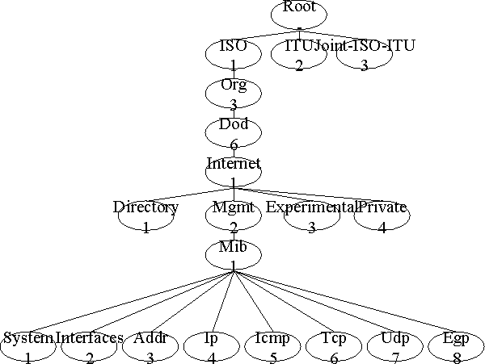
MIB Namespace

Slide 44
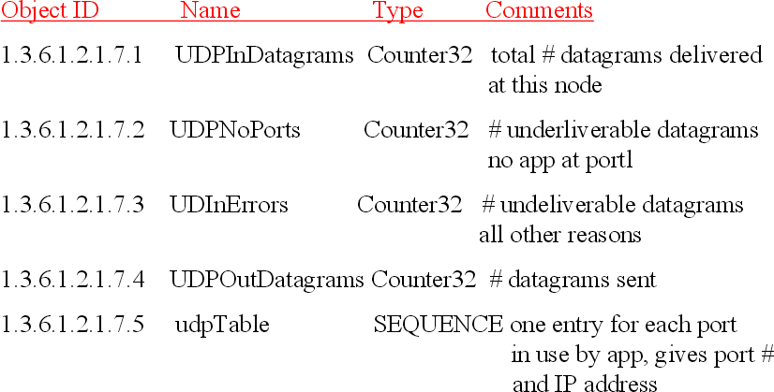
MIB Naming Examples

Slide 45
MIB-II
An example of a base set of parameters to monitor can be developed from the standard MIB-II. The following parameters can be collected on a per-interface basis:
ifInOctetsNumber of bytes received
ifOutOctetsNumber of bytes sent
ifInUcastPktsNumber of unicast packets received
ifOutUcastPktsNumber of unicast packets sent
ifInNUcastPktsNumber of multicast/broadcast packets received
ifOutNUcastPktsNumber of multicast/broadcast packets sent
ifInErrorsNumber of erroneous packets received
ifOutErrorsNumber of packets that could not be sent

Slide 46
Limitations and problems with SNMP
It is officially only standardised for use on IP networks
It is inefficient at large table retrievals
It uses cleartext strings for security

Slide 47
SNMP v2
Same basic function as SNMP
Original enhancement proposal was concerned primarily with security enhancement
Authentication
Message integrity
Privacy
Authorisation and access control

Slide 48
nmap: network port scanner
nmap checks a set of target hosts to see which TCP and UDP ports have servers listening on them
Find out what a system looks like to someone on the outside who is trying to break in
Do not run nmap on someone else’s network without permission from that network’s administrator

Slide 49
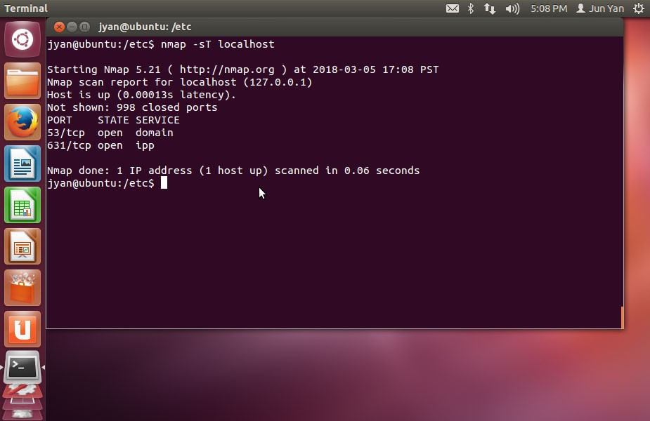

Slide 50
Domain Name System (DNS)
There are hundreds of countries, millions of networks and millions of hosts.
How do we keep track of all the nodes and networks.
Well we use a service called DNS (Domain Name Service).
The Domain Name Service is a distributed database which provides a lookup table for hostnames and IP addresses.
Humans prefer to refer to nodes on the internet by names, rather than IP addresses. In order for this to work, we need to convert these high level names into addresses. DNS performs name resolution to IP address (and also the opposite direction).
The Domain Name System also gives us a network hierarchy. It is responsible for giving structure to the Internet (from the users perspective).

Slide 51
The History Behind the Domain Name Service
When the Internet was first born (ARPANET)- the mapping between Hostnames and IP addresses was done in small files.
If a site wished to add a new computer to the network, they choose a name and added it to such files.
These files were distributed to other sites. Such a process consumed considerable bandwidth.
That said there were consistent problems keeping the data between sites up to date and in sync.
It soon became clear that this technique simply did not scale.
This mapping between names and IP addresses is extremely important because as humans we prefer to remember names as opposed to long sequences of numbers.
On Unix, you have already seen how the /etc/hosts file may contain such mappings;
130.130.217.198 wumpus.its.uow.edu.au

Slide 52
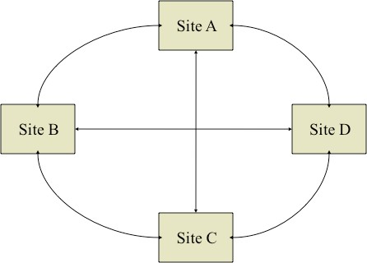
The exchange of host files between sites was too expensive, complex and inefficient.

Slide 53
The History Behind the Domain Name Service
The Domain Name System was created to address two problems;
The organization of the internet.
As ARPANET grew researchers began to realize that names for hosts were running out. So they needed to impose a hierarchy/ structure.
The synchronization of host databases.
Again as ARPANET grew it become more and more difficult to keep track of nodes. Data quickly became dated.

Slide 54
The History Behind the Domain Name Service
DNS was formally introduced by Paul Mockapetris in RFC’s 882 and 883 (around 1983).
The original version of DNS was designed and implemented at the University of California at Berkeley in 1984.
In 1985 the Berkeley Computer Systems Research Group absorbed the graduate students work and rolled it into the BSD project (Berkeley Software Distribution)
Kevin Dunlap in 1985 released BIND (Berkeley Internet Name Domain system) which has grown in popularity over the years.
Bind is currently in release 9 and an organisation called the Internet Software Consortium (ISC) has evolved from the work done at Berkeley. The ISC is a non-profit organisation funded by the USA government, community and private sector.

Slide 55
The History Behind the Domain Name Service
DNS has evolved since those early days and continues to evolve. Initiatives include:
DNSSEC
Secure DNS transactions i.e. the ability to move data between servers in a secure and trusted fashion.
IPv6 Support
With the adoption of IPv6, DNS has had to change only slightly.
It has also been an interesting time because vendors such as Microsoft have come up with several good ideas which have been rolled back into the DNS system.
For example Microsoft has developed the notion of Dynamic DNS which has had a profound impact.

Slide 56
So What is DNS?
In order to understand DNS, you need to understand the Internet.
The internet is made up of sites. These sites reflect networks or organisations.
Organisations can be grouped together depending on type.
Entities can be grouped together based upon geographic locality.
Ultimately DNS provides the following kind of functionality;
A hierarchal namespace for IP addresses.
A distributed database of host information.
A mechanism for finding services and nodes on a network.
A protocol for exchanging naming information to keep data current and synchronised between sites.

Slide 57
The Domain Name System Architecture
But how does it work?
The Domain name system defines a tree of domains. Each domain represents a chunk or grouping of the network which is managed by a single administrative entity.
The Domain Name Service is a global infrastructure managed by ICANN.
The Domain Name System defines what are known as Top Level Domains (TLDs).
These TLDs had not been changed in years. It used to be that certain TLDs represented specific kinds of networks.
But as the Internet has grown, ICANN added a few top level domains. And more recently, hundreds more!

Slide 58
gTLD
– Top level domains are sometimes referred to in the literature are gTLD’s (generic top level domains).
Domain | Use | Domain | Use
com | Commercial Entities | net | Network Providers
edu | Education Entities | org | Non profit organisations
gov | Government | int | International
mil | Military Networks | arpa | Old Style Arpanet

Slide 59
ccTLD
– Most of the top level domains are used within the United States. Outside the United states there are a number of top level country code domains ccTLD’s.
Some common country codes are
Code | County | Code | Country | Code | Country
au | Australia | fi | Finaland | hk | Hong Kong
ca | Canada | fr | France | ch | Switzerland
br | Brazil | jp | Japan | mx | Mexico
de | Germany | se | Sweden | mu | Hungary
– Most of these countries produce second level domains which are similar to the top level domains offered by the US.

Slide 60
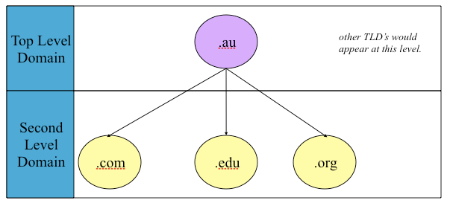
For example the internet has the following structure.
So considering this, www.uow.edu.au belongs to the uow domain which is part of the edu domain which is in au’s namespace.

Slide 61
Subdomain
You can infer from the DNS model that domains can be delegated to other authorities (sub domains).
.au has its own authority
And at the University, EIS have their own subdomain beneath the uow domain. The management of this eis.uow.edu.au domain is partially delegated.

Slide 62
Regional domains
Domains largely emerge due to congestion in the namespace - think about how many movies have been put in the .com domain!
Regional top level domains are managed by local authorities. For example in Australia .au domain registry is performed by AusRegistry, overseen by industry regulator auDA (.au Domain Administration). The control is authorised by ICANN.
The management of educational domains in Australia is done by a single private sector organization (Educause http://www.educause.edu/edudomain/)
If an organisation wishes to have a .com.au or .edu.au domain they need to speak to the appropriate authority.
Each domain on the Internet has at least one DNS server which keeps track of the network.
These DNS servers talk to the parent server and serve requests of clients around the world.
The top level domains have what are known as ‘root’ name servers. These process a huge number of requests and updates.

Slide 63
Obtaining a Domain.
Depending upon where you wish to create a domain you need to work with different agencies.
ICANN is responsible for delegating ‘authority’ to agencies to handle certain top level domains.
In Asia Pacific, www.apnic.net has a registry of all the domain and organisations that are managed.

Slide 64
Technical Details of DNS
There is no implicit tie between network numbers and domain names
However, it makes administrative sense to keep some relationship between networks and names.
The University of Wollongong domain happens to map nicely onto our network (although we have some smaller ranges in there as well).
130.130 - uow.edu.au
Because we are responsible for the domain we run a DNS server such as bind.
The people in the domain above us (edu.au) have told their DNS server that our DNS server is authoritative for the uow.edu.au sub domain.
The domain uow.edu.au is a delegation point in the edu.au
domain.
•

Slide 65
Small organisations can run servers on their own hosts or ask their ISP to supply DNS service
Medium-sized sites should run multiple DNS servers to reduce query latency
A very large site can divide its DNS domain into subdomains and run several server for each subdomain

Slide 66
Technical Details of DNS
Inside uow.edu.au there is a sub domain
cs.uow.edu.au (plus many others).
Although it is a sub domain, it is not a delegation point since the uow.edu.au DNS server is authoritative for that domain.
A DNS server may be authoritative for sub domains or may delegate responsibility to other DNS servers.

Slide 67
Types of DNS
There are several kinds of DNS Server
Authoritative
An authoritative server is one that is authorised to answer queries for a domain. It is guaranteed to be up to date. It is considered the official representative of a zone/domain.
Non-Authoritative.
A non-authoritative server answers a query typically from a cache. It does not know if the data is still valid.
In the Authoritative grouping we typically have these kinds of servers
Masters (Primary)
Slaves (Secondary)
The slave gets a copy of its records from the master using the SOA (Start of Authority) record for the zone.
Data is maintained between the master and slave using Zone Transfers (over TCP). We can control zone transfers using software e.g. ndc.
Non-Authoritative servers typically include things such as caches and forwarders.

Slide 68
Recursive vs Non Recursive Queries
There are two ways in which DNS servers can answer queries
Non-Recursive
If a DNS server is non-recursive it will only answer queries that
it has the answer for. These may be cached or they may be authoritative.
If it does not have the answer it returns the address of the server that is likely to know the answer.
Recursive
A recursive DNS server returns only names or errors. It follows the referrals to yield the answer.
The way this is done is by forwarding the query to a root server that is known.

Slide 69
Zone
A zone is essentially a domain minus its subdomains
Each zone typically has one master name server that keeps the official copy of the zone's data on disk
A zone can have several slave name servers that get their data from the master server through a zone transfer operation
Typically we have two zones;
Forward zone name to address mapping.
Reverse zone address to name mapping.
You may hear things like catching-only name server, non-authoritative name server, recursive name server, etc.

Slide 70
DNS Records
The information in the DNS system consists of records
SOA Start of Authority
NS Identifies Zones Servers
A Name to Address Mapping
PTR Address to Name Mapping
MX Mail Exchange (used for mail routing)
CNAME
Glue
Synonyms for hosts i.e. Nicknames A Record for a Nameserver

Slide 71
SOA
The SOA record indicates the beginning of a Zone.
In many regards a zone can be considered a grouping in the DNS namespace.
Typically we have two zones
Forward zone for name to address mapping.
Reverse zone for address to name mapping.
The SOA record typically contains the following
The name of the Zone.
The administrator for the Zone.
Timeout information e.g.
Serial is typically used to indicate last change.
Refresh specifies how often slave servers check with the master to see if the serial has changed.
Retry specifies how long after a failure a slave checks the master.
The SOA information is used by slaves to identify when it is necessary to do a Zone Transfer.
A Zone Transfer allows master and slave DNS servers to remain in sync.

Slide 72
NS
The NS record identifies which servers are authoritative for a zone. This is how we define master and secondary DNS servers.
If we do the following we get some interesting results:
$ dig uow.edu.au NS
Each domain should have a primary server and at least one secondary.
Primary and secondary name servers talk among themselves to ensure the consistency of the database.

Slide 73
A
The A records provide the name to address mappings in the DNS database. They basically represent the /etc/hosts file.
An A record would typically look like this:
yoshi IN A 130.130.64.68
This entry would be in the zone file representing the cs subdomain for the University.

Slide 74
PTR
The PTR records do the reverse of the A records.
A reverse DNS lookup for an IP address is NOT a search of the A records in reverse; it is a search of the PTR records for the IP address.
PTR records exist in a special part of the DNS namespace called in-addr.arpa.

Slide 75
In-addr.arpa
Domains under in-addr.arpa are named liked IP addresses with their bytes reversed.
For example at the University the cs zone is (was)
130.130.64.0/24
Thus the in-addr.arpa file will be called 64.130.130.in-addr.arpa.
It will typically contain records such as:
68 PTR yoshi
Some software requires names to be reversed for security purposes e.g. Telnet or
SSH.

Slide 76
MX
MX records are created to help routing of email.
A MX record knows where mail should be routed.
For a domain we can have more then one MX record. The mail router uses the MX record with the lowest priority that is available.

Slide 77
MX Example
– If I run:
$ dig uow.edu.au MX
;; ANSWER SECTION:
uow.edu.au. 3600 IN
MX 100 smtp-gateway.uow.edu.au.
I will get the MX record for the domain which points to the host smtp- gateway.its.uow.edu.au.
It has a priority of 100.
– If I do the same thing at gmail
$ dig gmail.com MX
;; ANSWER SECTION:
gmail.com. 455 IN MX gmail.com. 455 IN MX gmail.com. 455 IN MX gmail.com. 455 IN MX gmail.com. 455 IN MX
10 alt1.gmail-smtp-in.l.google.com.
5 gmail-smtp-in.l.google.com.
40 alt4.gmail-smtp-in.l.google.com.
30 alt3.gmail-smtp-in.l.google.com.
20 alt2.gmail-smtp-in.l.google.com.
we see five hosts. The priority decides where mail goes. We use this for redundancy purposes.

Slide 78
CNAME
CNAMES describe canonical names for hosts in the DNS namespace.
In the namespace we will typically see things like this:
wyrm | IN | A | 130.130.68.3
smtp | IN | CNAME | wyrm
ftp | IN | CNAME | wyrm

Slide 79
Other records
There are a few other records which are important to mention:
SRV records
SRV records describe priority, ports and other information for network resources/ hosts. This is particularly important in Zero Configuration networking.
TXT records
A TXT record adds arbitrary text to a hosts DNS record.

Slide 80
Adding a new machine to DNS (Bind server)
Assign an unused name and address to the new machine
Log into the master names server (use dig to find it)
Find the name server configuration file (usually
/etc/named.conf). Find the zone data files in the zone statement, e.g.,
zone “example.com” { type master;
file “filename”;
zone “188.77.208.in-addr.arpa” { type master;
file “filename”;

Slide 81
4. Identify the record of a similar machine in the same subnet, e.g.,
Duplicate this record and change it
accordingly
Edit the reverse zone file
100 IN PTR template.example.com.
Change the serial number in the SOA record at the beginning of the file
Reload the domain
sudo rndc reload forward-zone-filename sudo rndc reload reverse-zone-filename
template
IN A 208.77.188.100
IN MX 10 mail-hub

Slide 82
Hosts on the Network.
Machines may have many IP addresses, either on different hardware interfaces or the same hardware interface.
Each IP address may have its own name or not.
The name of the machine (uname) may not match any interface name.
Sensible people adopt a sensible naming scheme.
For example,
Machine name matches DNS name for main interface.
Each IP address has its own name.
Each interface has a single IP address and name.
Secondary interface names are derived from the primary name e.g. wraith-1

Slide 83
The Importance of DNS
Management of their IP addresses and DNS configuration is a complex and onerous task for an organisation of any size.
Do not underestimate the size of this problem or the complexity of DNS configuration.
Remember that nearly all network services depend on name resolution.
If DNS fails, most of your services will be down.
After your network fabric, DNS is probably the most important network service you will ever have.

Slide 84
The Resolver.
The resolver on a host is responsible for converting names to addresses. It forwards queries to the appropriate DNS servers.
Name server configuration is typically via a single configuration file. For Unix, that configuration file is called /etc/resolv.conf. (not a typo!)
– Such a file looks like this:
domain its.uow.edu.au
nameserver nameserver nameserver
130.130.68.1
130.130.64.1
129.78.64.1
options retry:2 retrans:5
search uow.edu.au cs.uow.edu.au

Slide 85
resolv.conf example
The file has a number of directives. The first is the Primary DNS domain for the current host.
domain
The next group of directives specify the name server to use to resolve queries.
its.uow.edu.au
Queries are sent to each server in order.
nameserver 130.130.68.1
nameserver 130.130.64.1
nameserver 129.78.64.1
For each server we can specify a series of option. In this case we are saying:
options retry:2 retrans:5
Wait 5 seconds for a reply.
Retry each nameserver 2 times before moving on and trying the next.
This is a very aggressive configuration.
If name does not resolve, try these domains as well.
search uow.edu.au cs.uow.edu.au
This is typically used when we do not provide a fully qualified DNS name.

Slide 86
Multi-homed Hosts
Machines may have multiple interfaces. We often see these devices in the device tree.
/dev/le0
/dev/hme4
Individual interfaces may be up or down.
The ifconfig command is used to display information about or configure an interface.
Information displayed includes the hardware address, the IP address, the broadcast address, the netmask, the MTU and some flags.

Slide 87
Important Files
Under Solaris, /etc/hostname.X controls the name (and therefore the IP address) of each interface.
/etc/nodename contains the nodename or system name of the machine.
Name/IP information comes from /etc/hosts
(needed since before interface operational, no way to get information from DNS)
Netmask information from /etc/netmasks
Network/name translation from /etc/networks
As a systems administrator you need to remember these files.
On most Unix implementations they are the same.

